Slide 1
The Battle of Neighborhood
Coursera Capstone Project
By: Vasu Maddineni

Slide 2
Introduction
Immigration is defined as the movement of people to live from their homeland or region to another country they are not native to.
Immigration has become increasingly common worldwide throughout history, with improved transportation and technology. In both the home country and the host country, immigration numbers affect.
Benefits:
Immigration has many advantages to it. Immigrants primarily choose to leave their homeland to improve their quality of life. Economic factors for immigration include higher pay rates, improved work conditions, a higher standard of life and incentives for employment

Slide 3
Problem Description
The neighborhoods of New York City and the city of Toronto are compared in this project. Both cities are very diverse and are the financial capitals of their respective countries. The similarity or dissimilarity is compared.
Both the cities are segmented and clustered their neighborhoods based on Borough in each city.
A detailed overview of most common venues in each cluster are discussed to prove the similarity and dissimilarity

Slide 4
Data Collection
Data
Data set for New York city is available in following link:
https://geo.nyu.edu/catalog/nyu_2451_34572
Data set for Toronto city is available in following link:
https://en.wikipedia.org/wiki/List_of_postal_codes_of_Canada:_M
Data Acquisition:
The data for New York has all the information Neighbourhood name, location details (Latitude and longitude)
Data for New York city has 5 boroughs and 306 neighborhoods.
The data of Toronto city has postal code, Neighbourhood name. I used Nominatim library from geopy to get the location details of Toronto City. Toronto city has 9 boroughs

Slide 5
Data Collection
Four-square API was is used to search for near by venues in each neighbourhood of Toronto city and New York city in the radius of 500 mt. The venue name and Venue category are extracted. The total number of venues in each category are counted and also the most frequent venue category for each neighbourhood is classified.

Slide 6
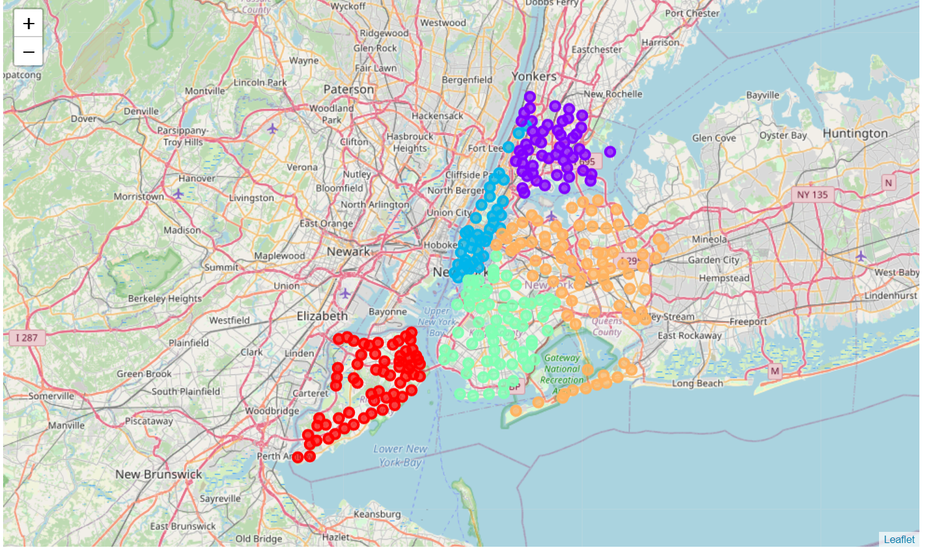
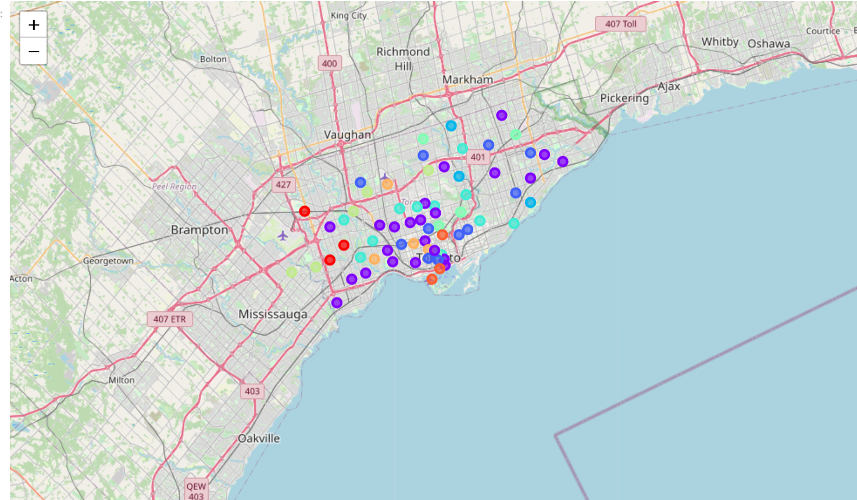
Maps of both Cities (Based on Borough)
New York
Toronto

Slide 7
Data Analysis:
Total number of Clusters specified are 6. (Some iterations are made to reduce the outliers). After the iteration total number of clusters is fixed to 6.
After retrieving all the data in the form of JSON file from Foursquare API. The data of near by venues in the radius of 500 mt of both Toronto city and New York city are merged.
According to the total number of venues in each category, I used K-means clustering algorithm to cluster the data.

Slide 8
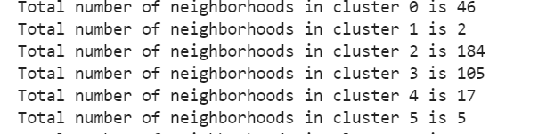
Clusters

Slide 9
Clusters
Cluster 1, cluster 5 are possible outliers.
Cluster 2 is good of residential purpose as I have all amenities in neighbourhood like bus stations, pharmacy stores, grocery stores.
Cluster 4 can be compared as downtown of Toronto and Manhattan area for New York with all types of venues
Cluster 0 and cluster3 have similar types of venues like restaurant’s with international cuisine and may be common places of hang out in both cities.

Slide 10
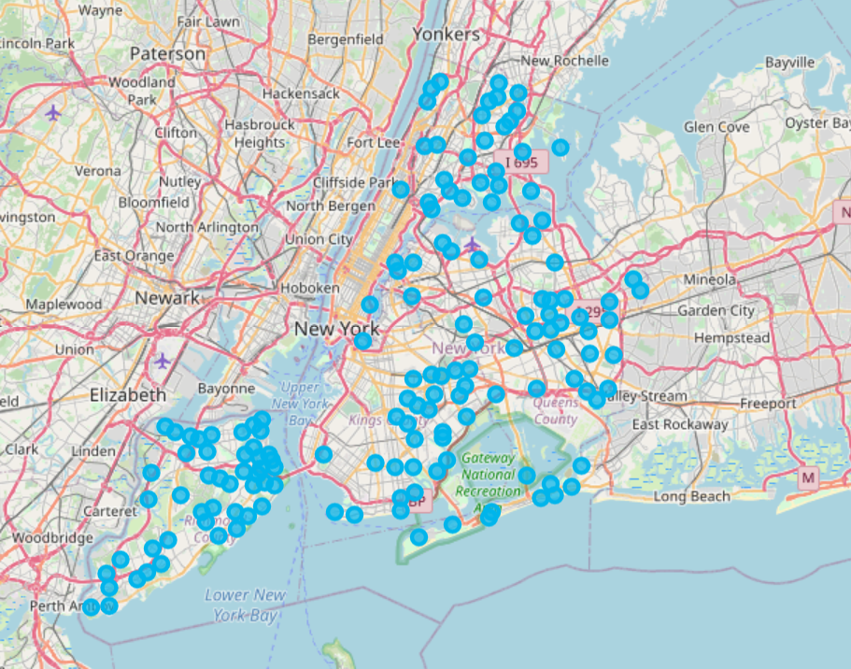
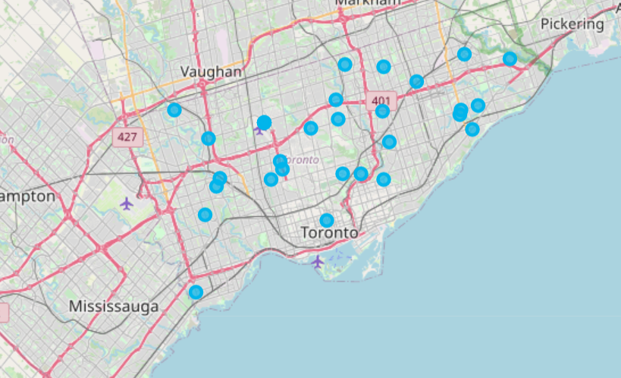
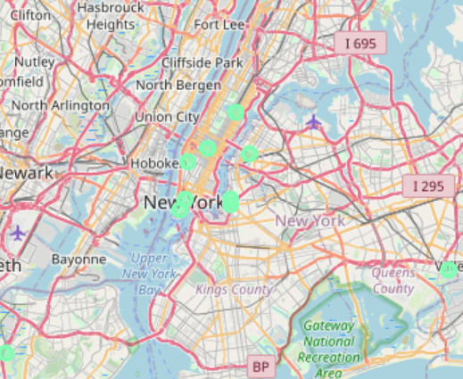
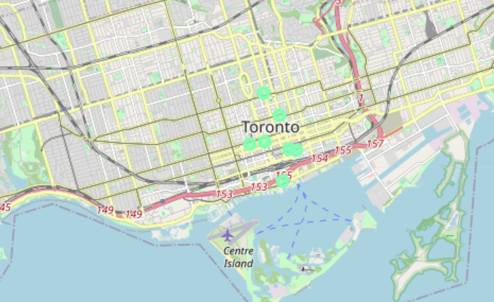
Cluster: 2 & 4
Cluster :2
Cluster :4

Slide 11
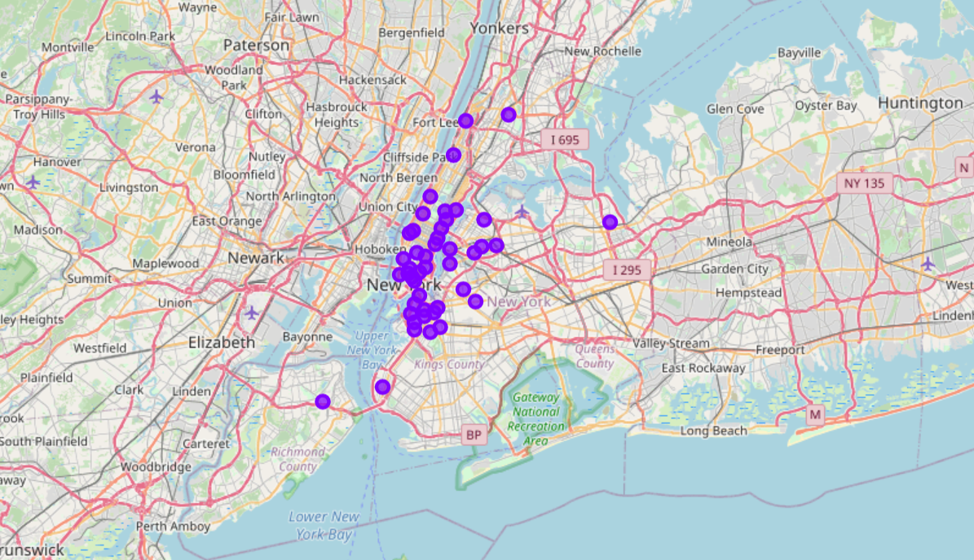
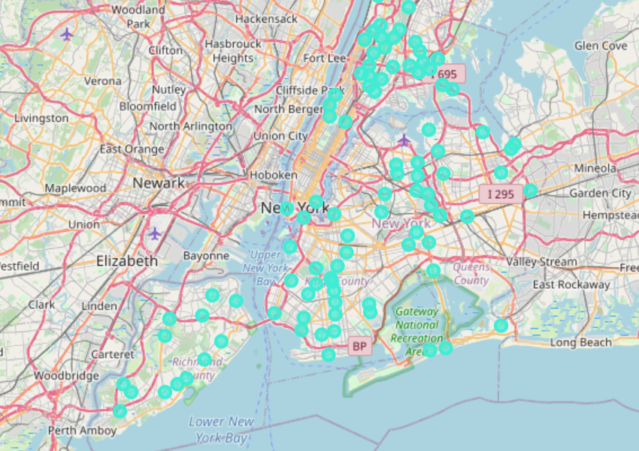
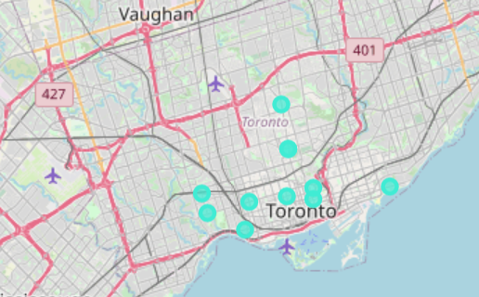
Cluster 0, 3
Cluster :0
Cluster :3

Slide 12
Conclusion
Both the cities being finical capital of respective countries share a common culture. Although New York is big compared to Toronto. The cities similar in terms of distribution.

Slide 13
Thank You !

